Slide 1
Blacktown Chinese Christian Church
Welcome to Our English Service 10.11.2024
English Service 9:45 – 11:00 am
Worship Songs: Passage: Speaker: Topic: Response Song: Announcements and Closing Prayer Benediction
Above All Who Am I What A Friend We Have In Jesus Colossians 2:8-23 TBA TBA TBA

Slide 2
BCCC english service

Slide 3

Please keep all phones on silent

Slide 4
Above All
Lenny LeBlanc, Paul Baloche © 1999 Integrity's Hosanna! Music (Admin. by Integrity Music) LenSongs Publishing (Admin. by LenSongs Publishing, Inc.) CCLI Licence No. 5485849 . CCLI Song number: 2672885

Slide 5
Verse 1
Above all powers, above all kings
Above all nature and all created things
Above all wisdom and all the ways of man
You were here before the world began

Slide 6
Verse 2
Above all kingdoms, above all thrones
Above all wonders the world has ever known
Above all wealth and treasures of the earth
There's no way to measure what You're worth

Slide 7
Chorus
Crucified, laid behind a stone
You lived to die, rejected and alone
Like a rose, trampled on the ground
You took the fall and thought of me, above all

Slide 8
Verse 1
Above all powers, above all kings
Above all nature and all created things
Above all wisdom and all the ways of man
You were here before the world began

Slide 9
Verse 2
Above all kingdoms, above all thrones
Above all wonders the world has ever known
Above all wealth and treasures of the earth
There's no way to measure what You're worth

Slide 10
Chorus
Crucified, laid behind a stone
You lived to die, rejected and alone
Like a rose, trampled on the ground
You took the fall and thought of me, above all (x2)

Slide 11
Outro
Like a rose, trampled on the ground
You took the fall and thought of me
Above all

Slide 12
Who Am I
Mark Hall © 2003 Be Essential Songs (Admin. by Essential Music Publishing LLC) CCLI Licence No. 5485849 . CCLI Song number: 4196651

Slide 13
Verse 1
Who am I, that the Lord of all the earth
Would care to know my name
Would care to feel my hurt?

Slide 14
Verse 1
Who am I, that the Bright and Morning Star
Would choose to light the way
For my ever wandering heart?

Slide 15
Pre-Chorus
Not because of who I am
But because of what You've done
Not because of what I've done
But because of who You are

Slide 16
Chorus
I am a flower quickly fading
Here today and gone tomorrow
A wave tossed in the ocean
A vapor in the wind

Slide 17
Chorus
Still, You hear me when I'm calling
Lord, You catch me when I'm falling
And You've told me who I am
I am Yours, I am Yours

Slide 18
Verse 2
Who am I, that the eyes that see my sin
Would look on me with love
And watch me rise again?

Slide 19
Verse 2
Who am I, that the voice that calmed the sea
Would call out through the rain
And calm the storm in me?

Slide 20
Pre-Chorus
Not because of who I am
But because of what You've done
Not because of what I've done
But because of who You are

Slide 21
Chorus
I am a flower quickly fading
Here today and gone tomorrow
A wave tossed in the ocean
A vapor in the wind

Slide 22
Chorus
Still, You hear me when I'm calling
Lord, You catch me when I'm falling
And You've told me who I am
I am Yours

Slide 23
Pre-Chorus
Not because of who I am
But because of what You've done
Not because of what I've done
But because of who You are

Slide 24
Chorus
I am a flower quickly fading
Here today and gone tomorrow
A wave tossed in the ocean
A vapor in the wind

Slide 25
Chorus
Still, You hear me when I'm calling
Lord, You catch me when I'm falling
You told me who I am
I am Yours, I am Yours, I am Yours

Slide 26
Outro
Whom shall I fear? Whom shall I fear?
'Cause I am Yours, I am Yours

Slide 27
What A Friend We Have In Jesus
CCLI Licence No: 5485849

Slide 28
Verse 1
What a friend we have in Jesus
All our sins and griefs to bear
What a privilege to carry
Everything to God in prayer

Slide 29
Verse 1
Oh what peace we often forfeit
Oh what needless pain we bear
All because we do not carry
Everything to God in prayer

Slide 30
Verse 2
Have we trials and temptations
Is there trouble anywhere
We should never be discouraged
Take it to the Lord in prayer

Slide 31
Verse 2
Can we find a friend so faithful
Who will all our sorrows share
Jesus knows our every weakness
Take it to the Lord in prayer

Slide 32
Chorus
Precious Jesus, Lord and Friend
I give everything to You
Shelter, Shepherd, Savior King
I give everything to You

Slide 33
Verse 3
Are we weak and heavy laden
Cumbered with a load of care
Precious Savior, still our refuge
Take it to the Lord in prayer

Slide 34
Verse 3
Do thy friends despise, forsake thee
Take it to the Lord in prayer
In His arms He'll take and shield thee
Thou wilt find a solace there

Slide 35
Verse 3
Thou wilt find a solace there

Slide 36
Chorus
Precious Jesus, Lord and Friend
I give everything to You
Shelter, Shepherd, Savior King
I give everything to You (x2)

Slide 37

Bible reading

Slide 38
Bible reading: Colossians 2:8-23
⁸ See to it that no one takes you captive through hollow and deceptive philosophy, which depends on human tradition and the elemental spiritual forces of this world rather than on Christ.
⁹ For in Christ all the fullness of the Deity lives in bodily form,

Slide 39
Bible reading: Colossians 2:8-23
¹⁰ and in Christ you have been brought to fullness. He is the head over every power and authority. ¹¹ In him you were also circumcised with a circumcision not performed by human hands. Your whole self ruled by the flesh was put off when you were circumcised by Christ,

Slide 40
Bible reading: Colossians 2:8-23
¹² having been buried with him in baptism, in which you were also raised with him through your faith in the working of God, who raised him from the dead.
¹³ When you were dead in your sins and in the uncircumcision of your flesh, God made you alive with Christ. He forgave us all our sins,

Slide 41
Bible reading: Colossians 2:8-23
¹⁴ having canceled the charge of our legal indebtedness, which stood against us and condemned us; he has taken it away, nailing it to the cross. ¹⁵ And having disarmed the powers and authorities, he made a public spectacle of them, triumphing over them by the cross.

Slide 42
Bible reading: Colossians 2:8-23
¹⁶ Therefore do not let anyone judge you by what you eat or drink, or with regard to a religious festival, a New Moon celebration or a Sabbath day. ¹⁷ These are a shadow of the things that were to come; the reality, however, is found in Christ.

Slide 43
Bible reading: Colossians 2:8-23
¹⁸ Do not let anyone who delights in false humility and the worship of angels disqualify you. Such a person also goes into great detail about what they have seen; they are puffed up with idle notions by their unspiritual mind. ¹⁹ They have lost connection with the head, from whom the whole body, supported and held together by its ligaments and sinews, grows as God causes it to grow.

Slide 44
Bible reading: Colossians 2:8-23
²⁰ Since you died with Christ to the elemental spiritual forces of this world, why, as though you still belonged to the world, do you submit to its rules: ²¹ “Do not handle! Do not taste! Do not touch!”?

Slide 45
Bible reading: Colossians 2:8-23
²² These rules, which have to do with things that are all destined to perish with use, are based on merely human commands and teachings. ²³ Such regulations indeed have an appearance of wisdom, with their self-imposed worship, their false humility and their harsh treatment of the body, but they lack any value in restraining sensual indulgence.

Slide 46
Announcements

Slide 47





Account name: Blacktown Chinese Christian Church
Account number: 4216 50263
Offering
BSB: 112 - 879
Please put in "offering" as the reference
The offering box is available at the back of the hall

Slide 48
Prayer points

Slide 49
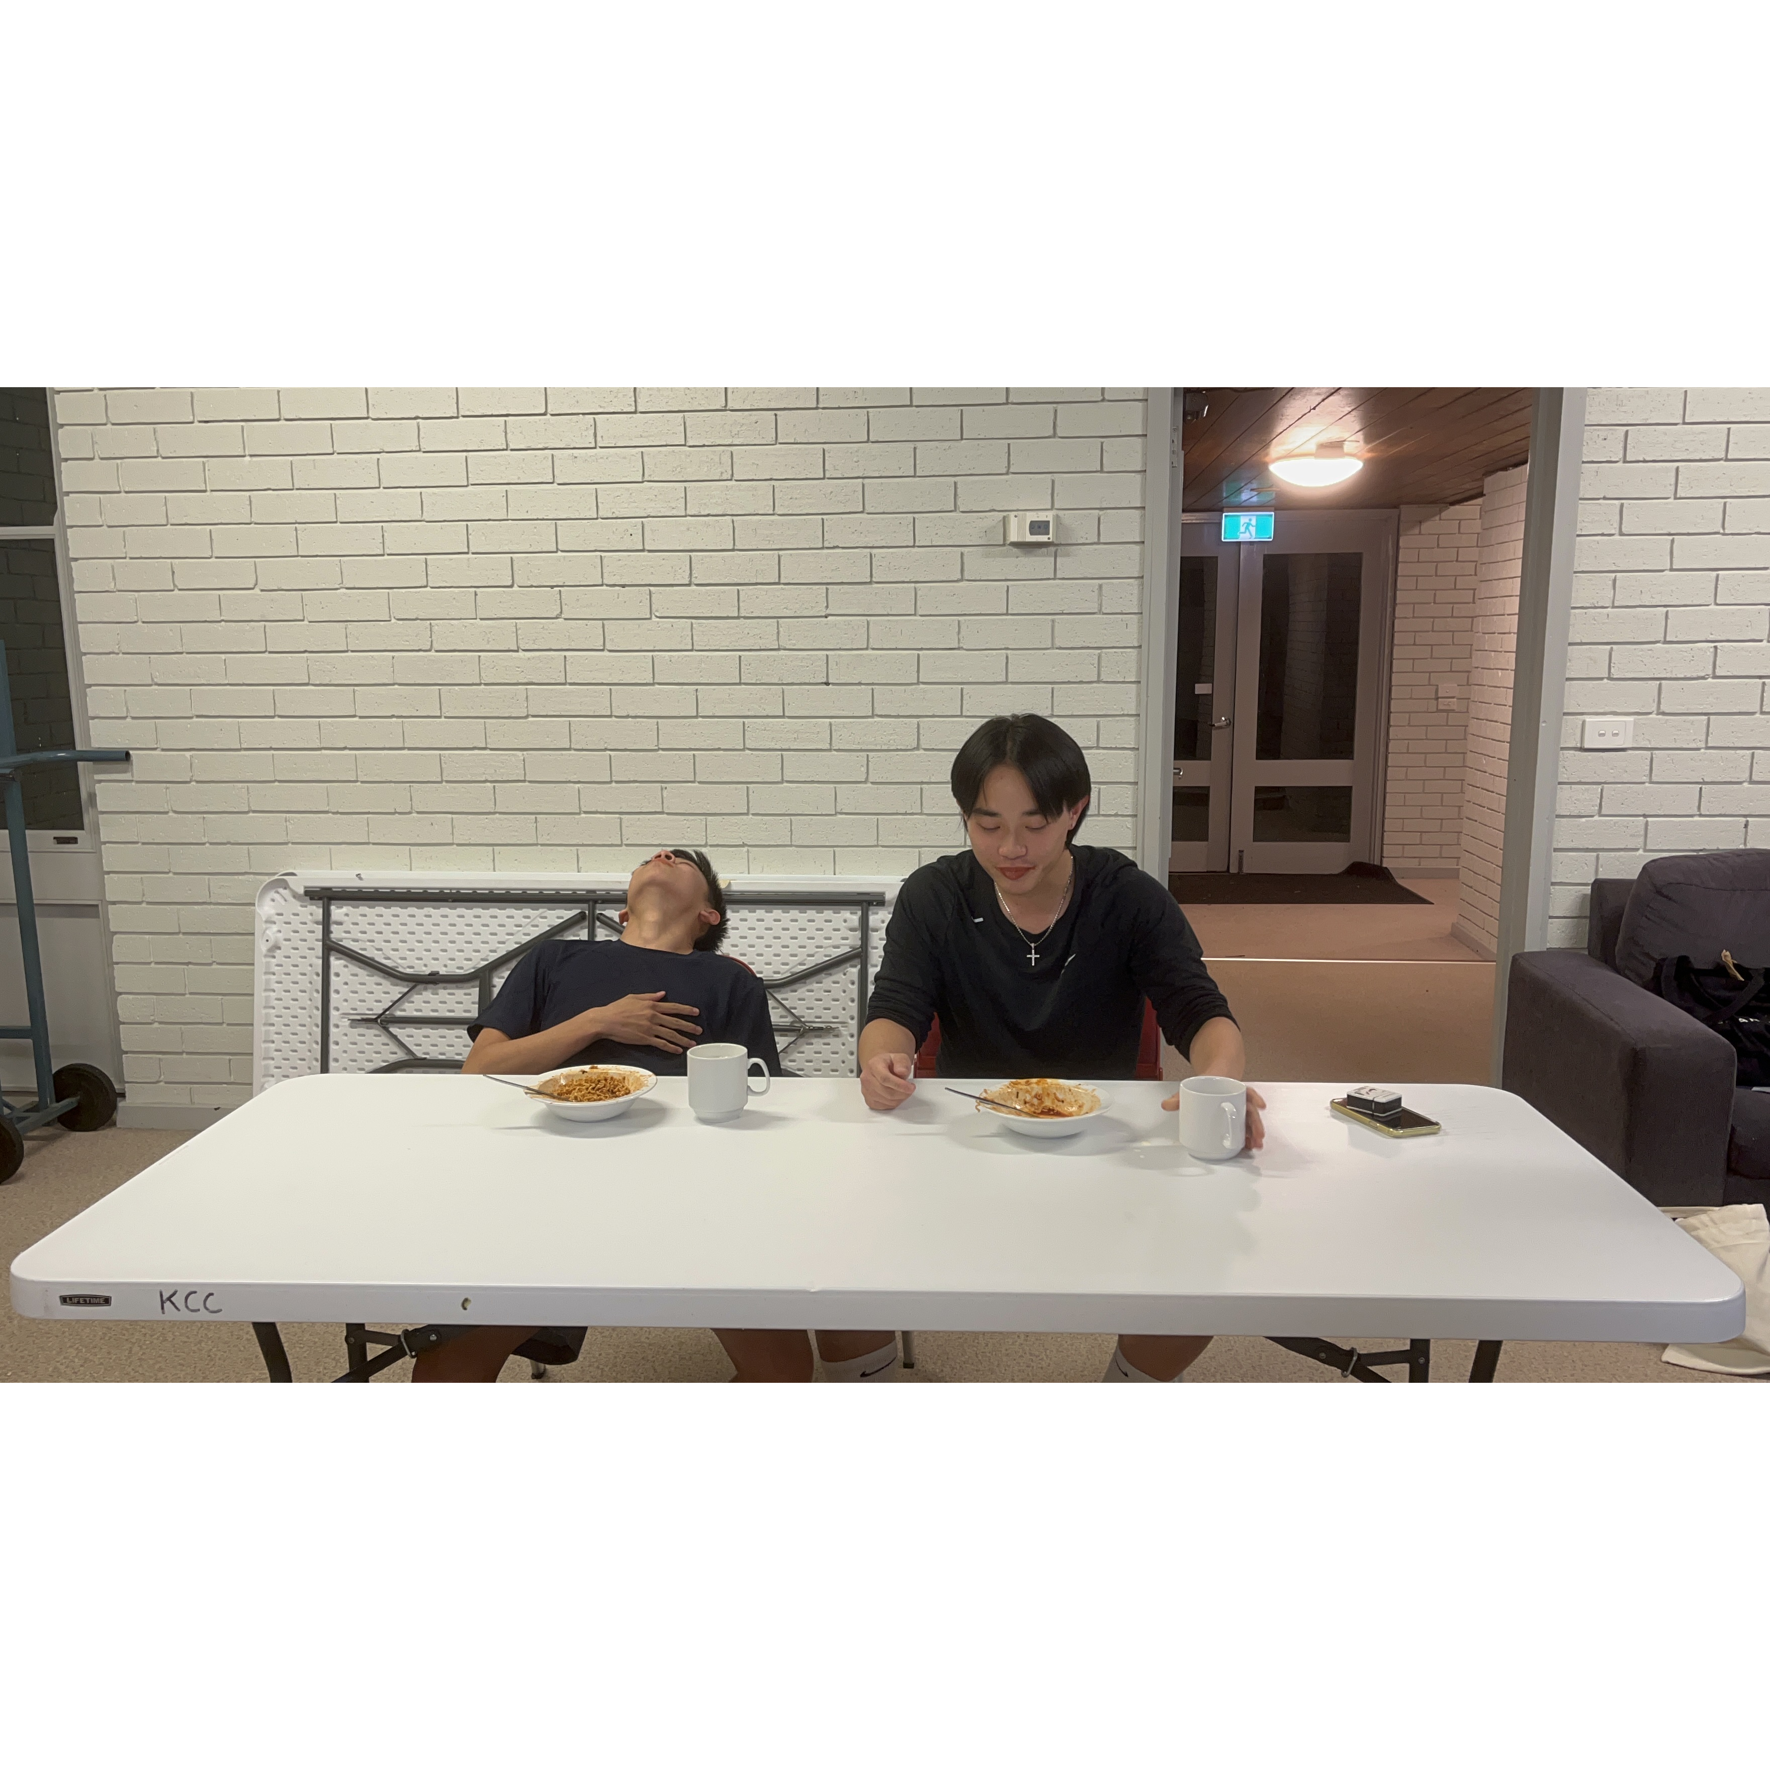
Mingle time!

